Slide 1
Data Structure & Algorithms
Maryam Imtiaz Malik
maryam.imtiaz@numl.edu.pk

Slide 2
What is a stack?
It is an ordered group of homogeneous items.
Items are added to and removed from the top of the stack
LIFO property: Last In, First Out
The last item added would be the first to be removed
TOP OF THE STACK
TOP OF THE STACK

Slide 3
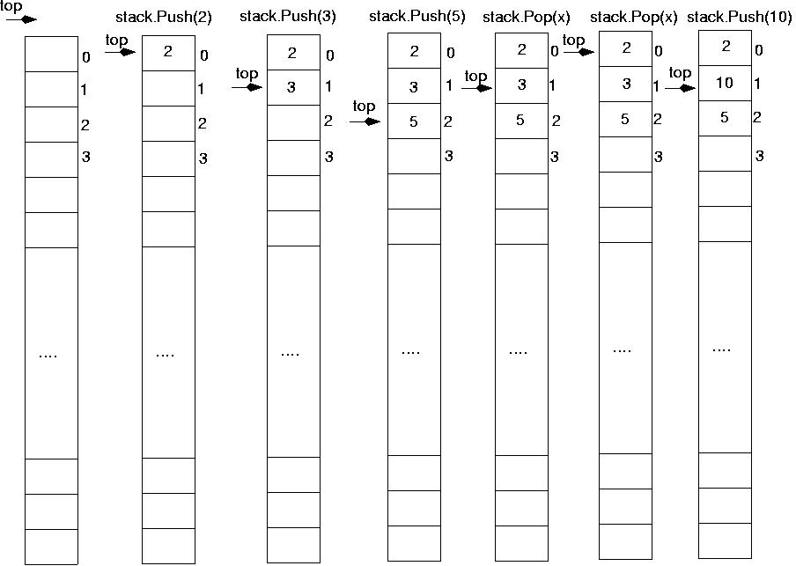
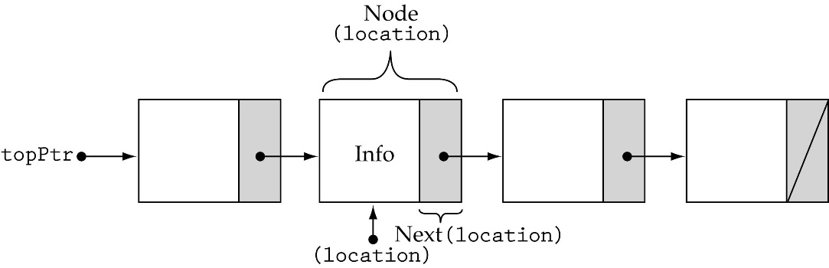
Stack Implementations
Array-based
Linked-list-based

Slide 4
Array-based Stacks
template<class ItemType>
class StackType {
public:
StackType(int);
~StackType();
bool IsEmpty() const;
bool IsFull() const;
ItemType Top() const;
void Push(ItemType);
void Pop();
private:
int top, maxStack;
ItemType *items;
};
dynamically allocated array
Notes:
int *a;
a = new int;
A = new int[5];

Slide 5
Array-based Stacks (cont’d)
template<class ItemType>
StackType<ItemType>::StackType(int size)
{
top = -1;
maxStack = size;
items = new ItemType[maxStack];
}
template<class ItemType>
StackType<ItemType>::~StackType()
{
delete [ ] items;
}
O(1)
O(1)

Slide 6
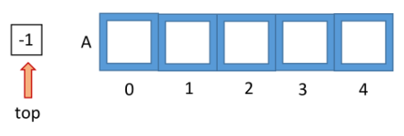
Array-based Stacks (cont.)
template<class ItemType>
bool StackType<ItemType>::IsEmpty() const
{
return (top == -1);
}
template<class ItemType>
bool StackType<ItemType>::IsFull() const
{
return (top == maxStack-1);
}
O(1)
O(1)

Slide 7
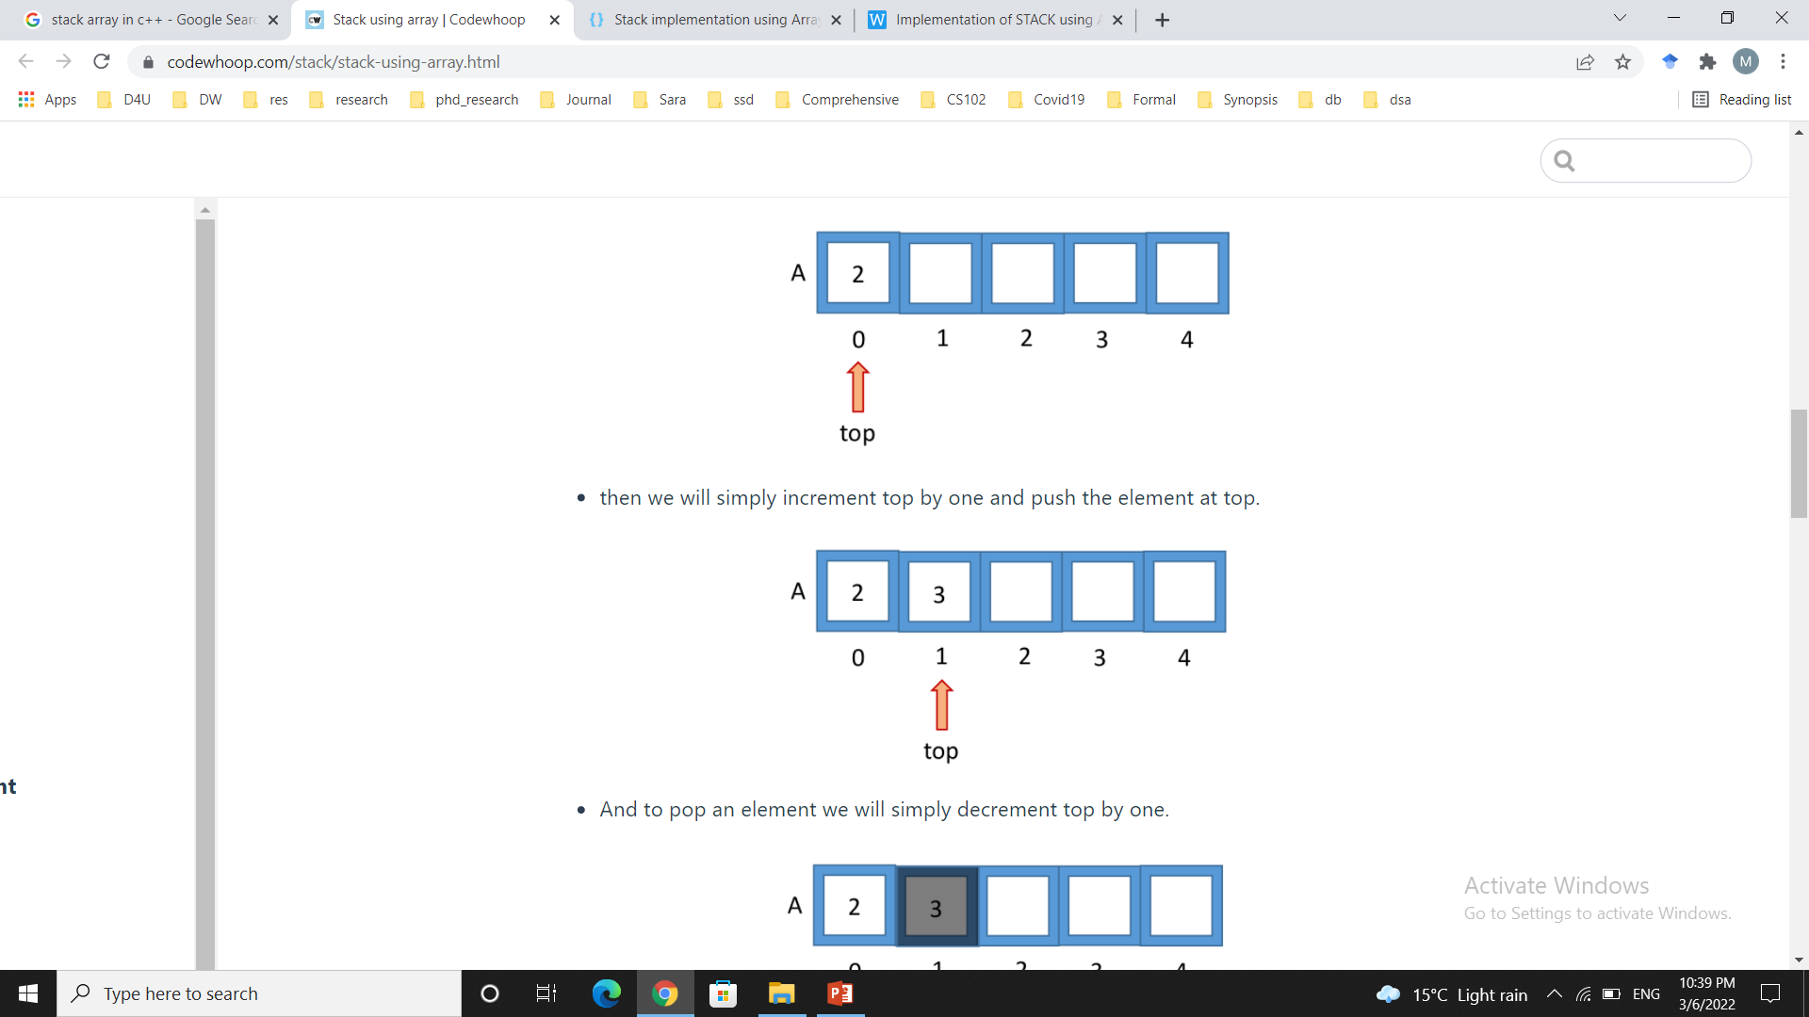
Push (ItemType newItem)
Function: Adds newItem to the top of the stack.
Preconditions: Stack has been initialized and is not full.
Postconditions: newItem is at the top of the stack.

Slide 8
Stack overflow
The condition resulting from trying to push an element onto a full stack.
if(!stack.IsFull())
stack.Push(item);

Slide 9
Array-based Stacks (cont.)
template<class ItemType>
void StackType<ItemType>::Push(ItemType newItem)
{
top++;
items[top] = newItem;
}
O(1)

Slide 10
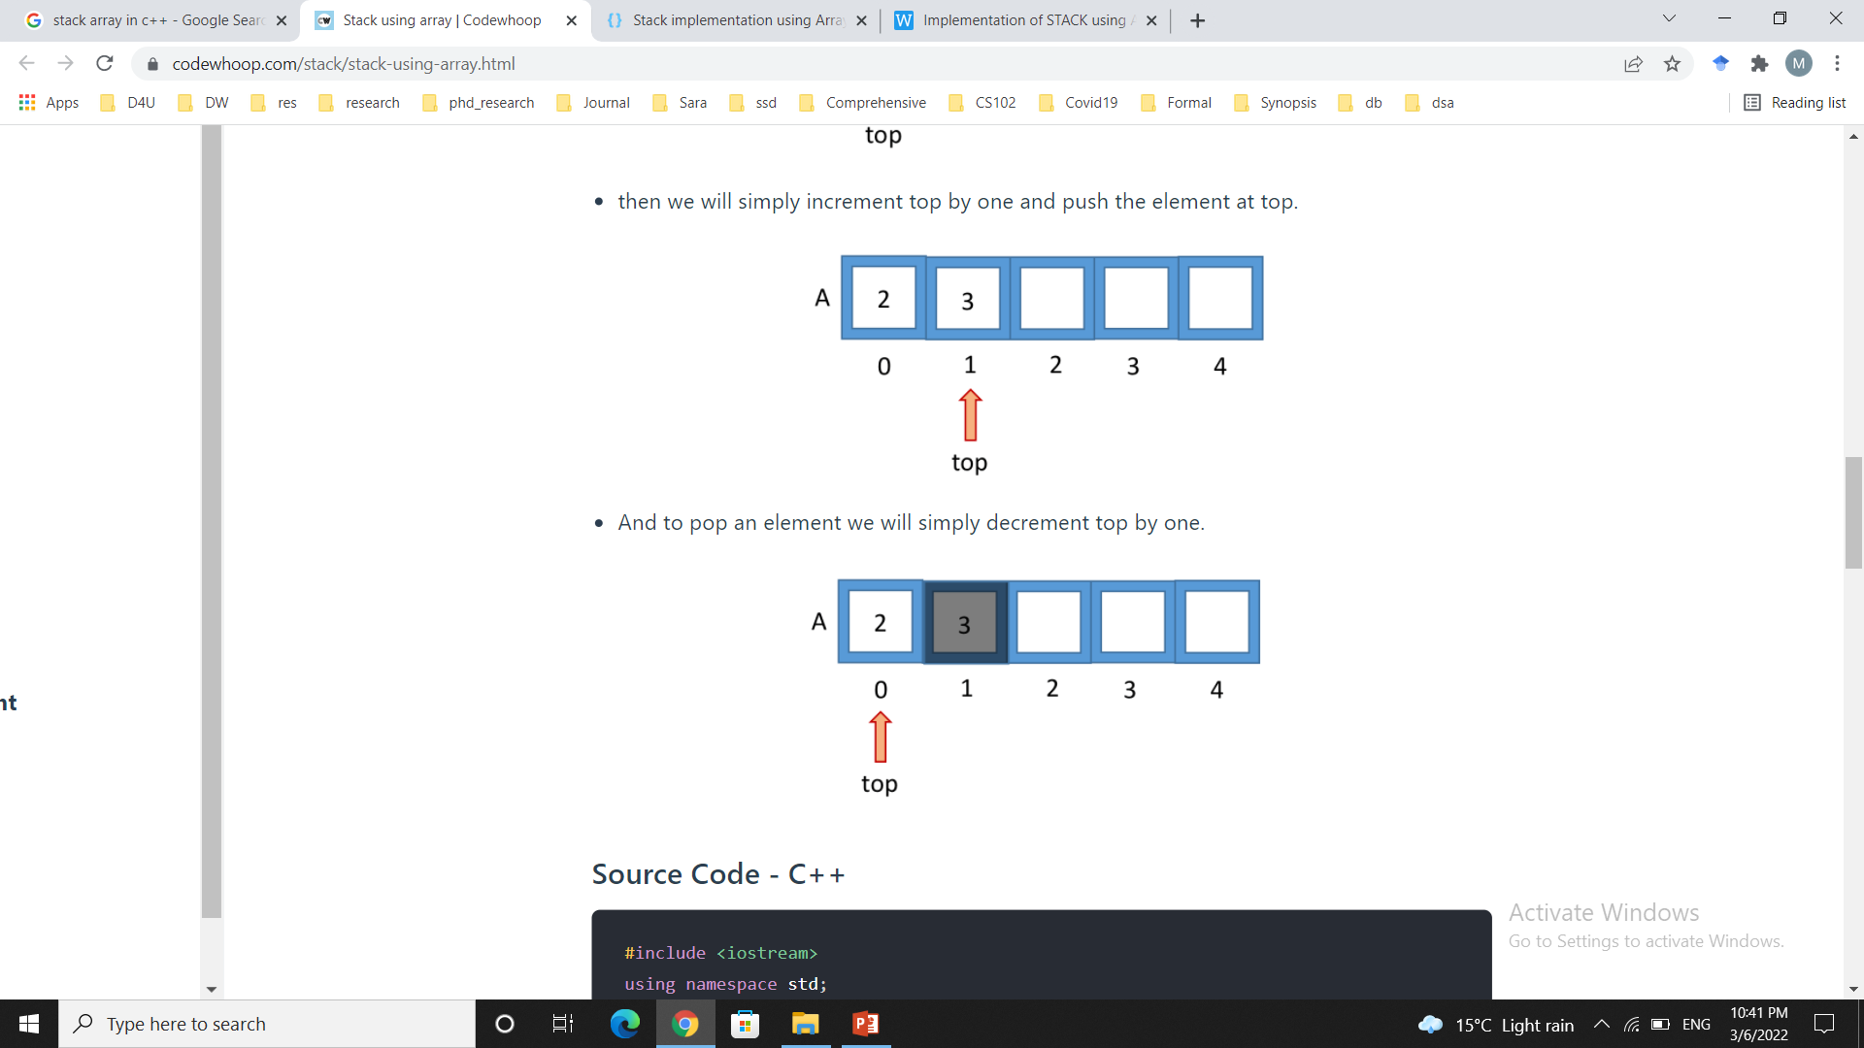
Pop (ItemType& item)
Function: Removes topItem from stack and returns it in item.
Preconditions: Stack has been initialized and is not empty.
Postconditions: Top element has been removed from stack and item is a copy of the removed element.

Slide 11
Stack underflow
The condition resulting from trying to pop an empty stack.
if(!stack.IsEmpty())
stack.Pop(item);

Slide 12
Array-based Stacks (cont.)
template<class ItemType>
void StackType<ItemType>::Pop()
{
top--;
}
O(1)

Slide 13
Array-based Stacks (cont.)
template<class ItemType>
ItemType StackType<ItemType>::Top() const
{
return items[top];
}
O(1)

Slide 14
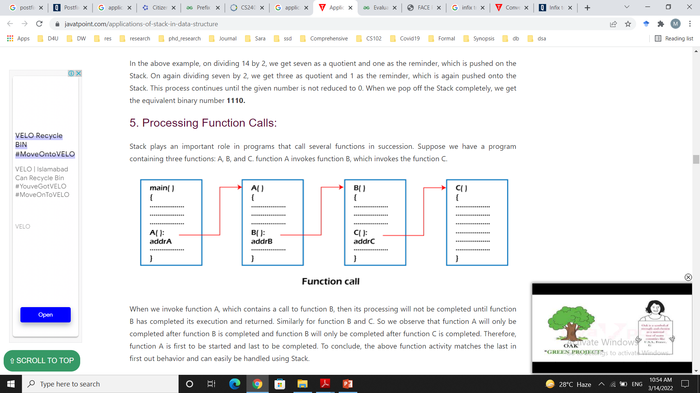
Application of Stacks
Evaluating Arithmetic Expression
Reverse of String
Parenthesis Matching
Processing Function Calls

Slide 15
Arithmetic Expression Evaluation
Infix Notation -> a + b
Prefix Notation -> +ab
Postfix Notation -> ab+

Slide 16
Arithmetic Expression Evaluation
Prefix and Postfix expressions can be evaluated faster than an infix expression. This is because we don’t need to process any brackets or follow operator precedence rule. In postfix and prefix expressions which ever operator comes before will be evaluated first, irrespective of its priority. Also, there are no brackets in these expressions. As long as we can guarantee that a valid prefix or postfix expression is used, it can be evaluated with correctness.

Slide 17
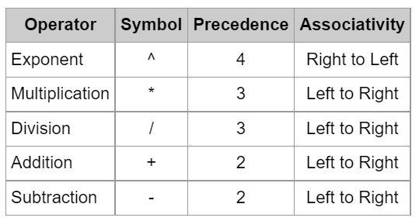
Operator Precedence

Slide 18
Infix to Prefix Notation
First, reverse the given infix expression.
Scan the characters one by one.
If the character is an operand, copy it to the prefix notation output.
If the character is a closing parenthesis, then push it to the stack.
If the character is an opening parenthesis, pop the elements in the stack until we find the corresponding closing parenthesis.
If the character scanned is an operator
If the operator has precedence greater than or equal to the top of the stack, push the operator to the stack.
If the operator has precedence lesser than the top of the stack, pop the operator and output it to the prefix notation output and then check the above condition again with the new top of the stack.
After all the characters are scanned, reverse the prefix notation output.
Notes:
(a+b)*c = * + abc

Slide 19
Infix to Prefix Conversion
(a + b) * (c + d)
Reverse the expression
)d + c ( * ) b + a (

Slide 20
Infix to Prefix Conversion Contd.
Symbol Scanned | Stack | Output
) | ) | -
d | ) | d
+ | )+ | d
c | )+ | d c
( |  | d c +
* | * | d c +
) | * ) | d c +
b | * ) | d c + b
+ | * ) + | d c + b
a | * ) + | d c + b a
( | * | d c + b a +
 |  | d c + b a + *
* + a b + c d

